Slide 1
18-349: Introduction to Embedded Real-Time Systems
Lecture 18: Real-Time OS Frameworks
Anthony Rowe
Electrical and Computer Engineering
Carnegie Mellon University

Slide 2
Administrivia
Lab 3 Due Monday Lab 4 goes out Monday

Slide 3
Course Feedback
Pace of Course
Lab Difficulty
Lecture Pace
Examinations
Approximate Hours per Week
CONINUE Doing
STOP Doing
START Doing
Other

Slide 4
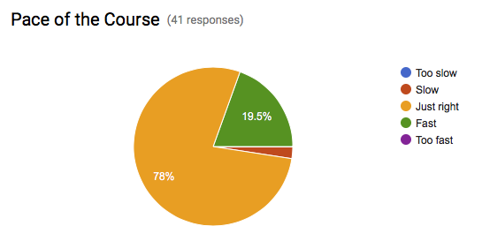
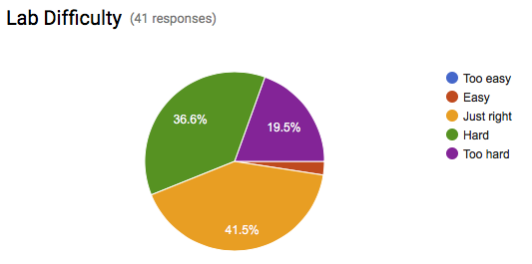

Slide 5
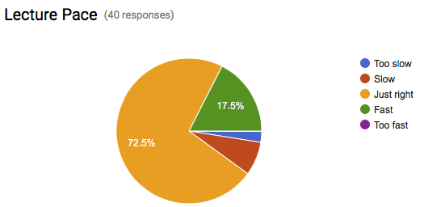
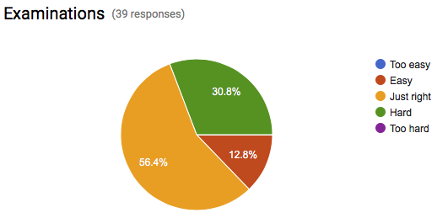

Slide 6
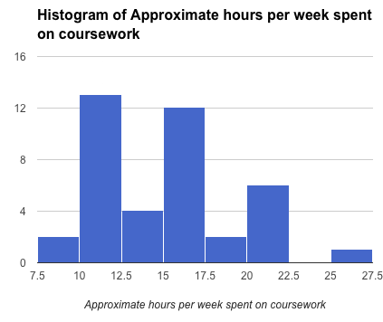
Time Spend on Course
14 average

Slide 7
Things to CONTINUE Doing
4 x Learning about different systems + real world examples
4 x Double office hours / Office hours every day
2 x Hints for Labs during lecture
2 x Interesting Lab Assignments
1 x Open Note Tests
1 x Break in middle of class
1 x Midterm review
1 x Posting slides before class

Slide 8
Things to STOP Doing
3 x Long Office Hour Wait times
2 x Monday Deadlines
1 x Assignments with lack of resources
1 x No Lab feedback
1 x Buggy Lab Handouts
1 x Vague labs
1 x Lecture material doesn’t match labs
1 x Ignoring Piazza and coming late to office hours
1 x Reading off lectures slides during lecture

Slide 9
Things to START Doing
11 x More Office hours
4 x Slides before lecture
2 x Improve connection between lectures and labs
1 x Text book
1 x Help with obscure parts of the lab
1 x Respond faster on Piazza
1 x Talk about Virtual Memory
1 x More Lab Feedback
1 x Move deadlines to Wednesday / Friday
1 x Starter code for labs
1 x Late days for labs
1 x Final Project
1 x Lab Recitations

Slide 10
Other Comments
Lots of variability in lab time
Stop assuming OS (15-410) information is taught in 213
Pick better TAs (ouch!)

Slide 11
Things we can fix?
Starting Now…
Monday deadlines -> We can shift to Wednesday
TA’s being late / sloppy -> I’ll share ALL of the comments with them
Posting lectures early
Next Time…
Improved lab handouts (will give points for improvements)
Lecture / Lab coupling (I’m working on it…)
Will switch to late days for the labs
Maybe release intermediate solutions (not sure about that yet)

Slide 12
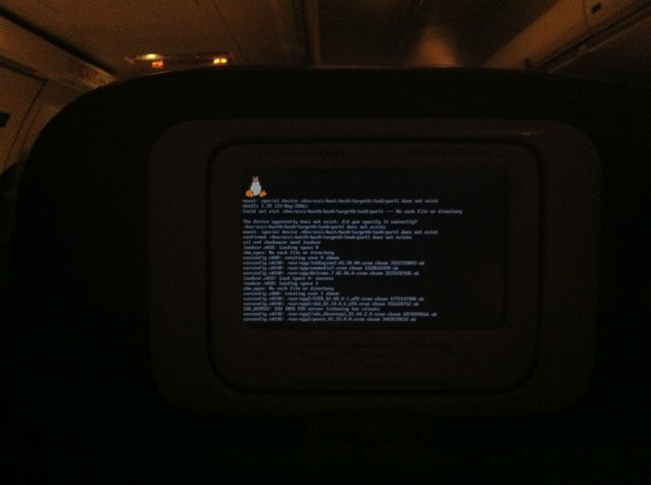

Why run Linux on it?
Why run Linux on an airplane?
Right now just for the infotainment system…
Why run Linux on a fighter jet in the future?

Slide 13
Outline of Lecture
Approaches limiting Real-time and Non-Real-time Task Interactions
Compliant Kernel Approach
Dual/Thin Kernel Approach
Approaches that integrate Real-time and Non Real-time tasks
Core Kernel Approach
Resource Kernel Approach

Slide 14
Approaches to Real-Time Linux
Approaches limiting Real-time and Non-Real-time Task Interactions
Compliant Kernel Approach
LynxOS/Blue Cat Linux
Dual Kernel Approach
RTLinux/RTAI
Approaches that integrate Real-time and Non Real-time tasks
Core Kernel Approach
Monta Vista Linux, TimeSys Linux
Resource Kernel Approach
Linux/RK

Slide 15
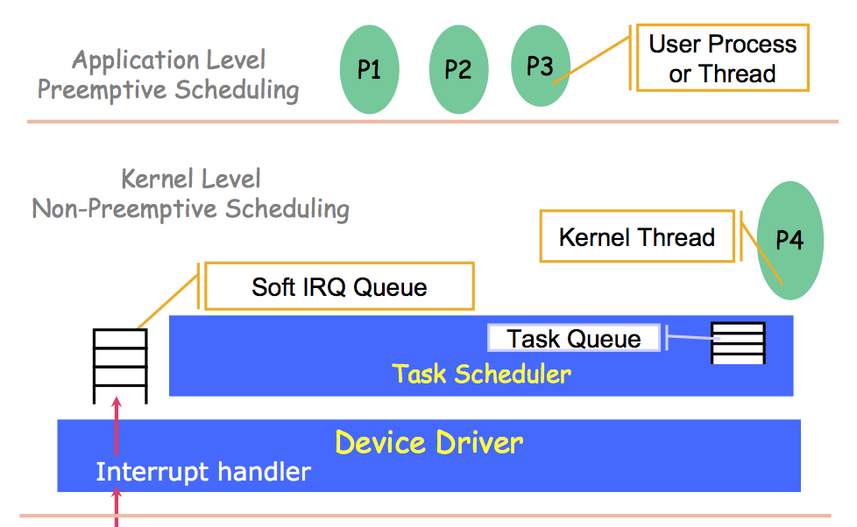
Linux Internals: Scheduling (1-2)

Slide 16
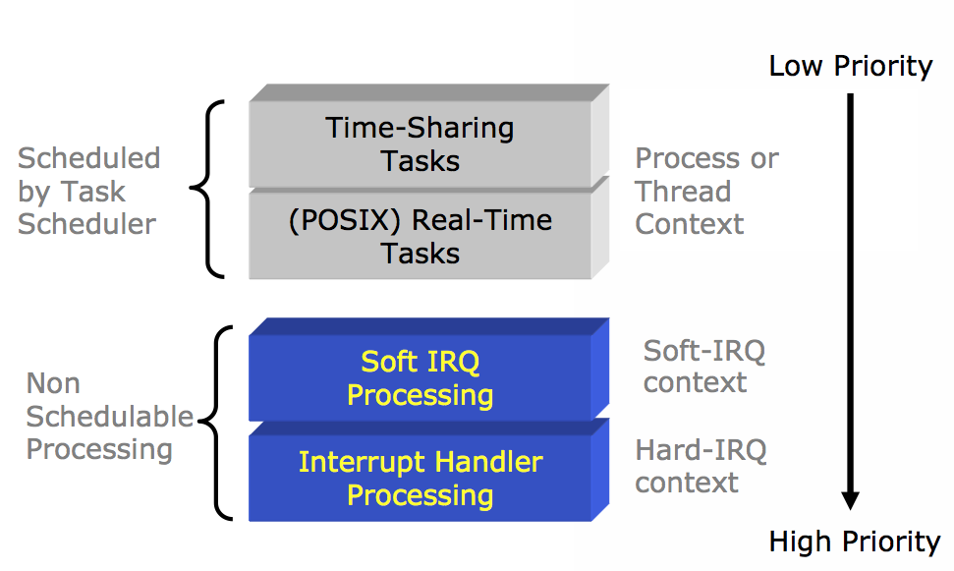
Linux Internals: Scheduling (2-2)

Slide 17
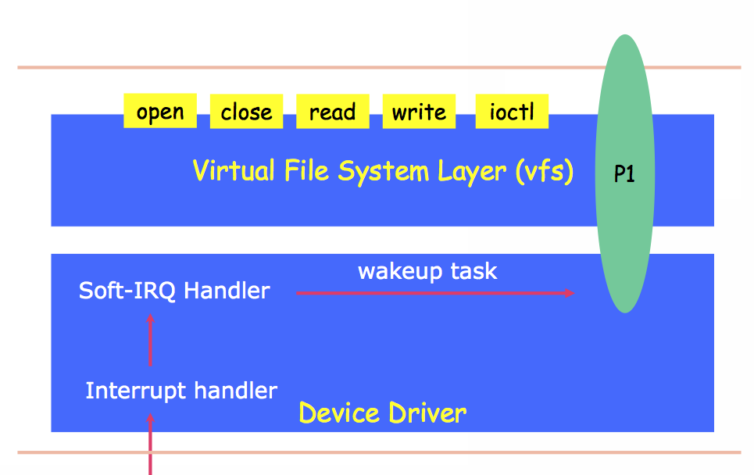
Linux Device Driver

Slide 18
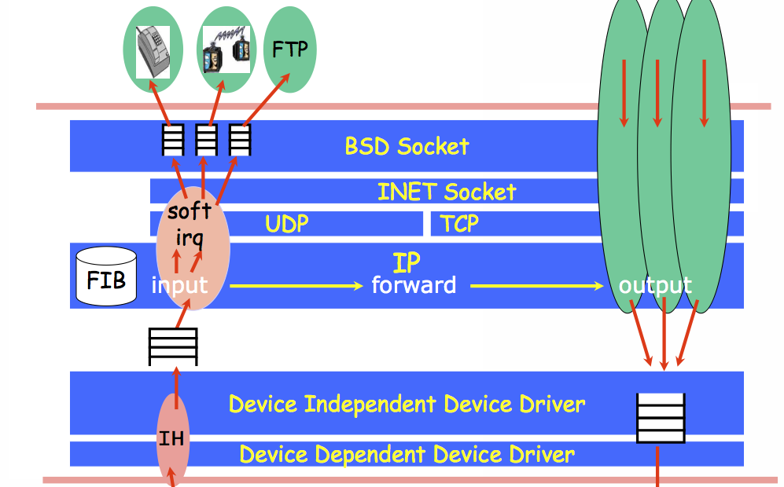
Linux Networking

Slide 19
Linux and Real-Time: Traditional Problems
Timer Granularity
Many real-time tasks are driven by timer interrupts
In Standard Linux, the timer was set to expire at 10 ms intervals
Beginning to change with usage of high-resolution timer and timestamp counters
Scheduler Predictability
The Linux scheduler used to keep tasks in an unsorted list
Requires a scan of all tasks to make a scheduling decision
Scales poorly as number of tasks increases, and is especially poor for real-time performance
Various subsystems NOT designed for real-time use
Network protocol stack
Filesystem
Windows manager

Slide 20
Approaches to Real-Time Linux
Compliant Kernel Approach
Dual Kernel Approach
Core Kernel Approach
Resource Kernel Approach

Slide 21
Compliant Kernel Approach
Linux Development Tools
And Environment
Linux Development Tools
And Environment
Linux System Call API
Linux System Call API
Linux Kernel
(Embedded Applications)
Real-Time Kernel
(Real-Time Applications)

Slide 22
Compliant Kernel Approach
Basic Claim
Linux is defined by its API and not by its internal implementation
The real-time kernel is a non-Linux kernel
Implications
No benefits from the Linux kernel
Not possible to benefit from the Linux kernel evolution
Not possible to use Linux hardware support
Not (always) possible to use Linux device drivers

Slide 23
Compliance
100% Linux API
Support all of Linux kernel API
Pros
Any Linux application can run on real-time kernel
Development can be done on a Linux host, with a rich set of host tools for development
All Linux libraries are trivially available to run on a real-time kernel
Third-party software
Cons
Achieving 100% Linux API is non-trivial
Consider the amount of effort put into Linux kernel development
What about cool Linux Kernel features?

Slide 24
Approaches to Real-Time Linux
Compliant Kernel Approach
Dual Kernel Approach
Core Kernel Approach
Resource Kernel Approach

Slide 25
Dual Kernel Philosophy
Linux is broken for real-time; Forget it!
Real-Time needs an RTOS
Linux is good for non-real time components

Slide 26
The Thin (Dual) Kernel Approach
Linux
Process
Linux
Process
User-Level
Kernel-Level
Linux Kernel
Real-Time
Task
Real-Time
Task
Real-Time
Task
Real-Time Kernel (RT-Linux or RTAI)
Hardware
Real-time tasks do NOT use the Linux API or Linux facilities
Failure in any real-time task crashes the entire system

Slide 27
Dual Kernel Approach
Pros
Requires little change to Linux Kernel
Real-Time tasks have tight timing
Linux apps can run along side RT apps
Cons
No memory protection on real-time side
Duplicate Functionality
Bloat
Extensibility?
Sharing of devices between RT side and Linux side
Starvation of non-RT tasks

Slide 28
Approaches to Real-Time Linux
Compliant Kernel Approach
Dual Kernel Approach
Core Kernel Approach
Resource Kernel Approach

Slide 29
Core Kernel Approach
Basic Ideas
Make the kernel more suitable for real-time
Ensure that the impact of changes is localized so that
Kernel upgrades can be easily incorporated
Kernel reliability and scalability is not compromised
Mechanisms
Static Configuration
Can be configured at compile time
Dynamic Configuration
Using loadable kernel modules

Slide 30
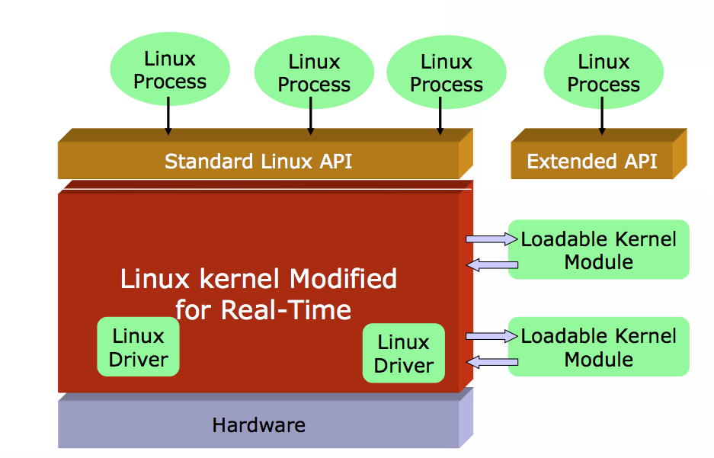
Core Kernel Approach

Slide 31
Core Kernel Approach
Allows the use of most, if not all, existing Linux primitives, applications, and tools.
Need to avoid primitives that can take extended time in the kernel
Allows the use of most existing device drivers written to support Linux.
Need to avoid poorly written drivers that unfairly hog system resources
Robustness and Reliability
Core kernel modifications can affect robustness, but source is available and extensive testing can be done.

Slide 32
Approaches to Real-Time Linux
Compliant Kernel Approach
Dual Kernel Approach
Core Kernel Approach
Resource Kernel Approach

Slide 33
Resource Kernel
A Kernel that provides to Applications Timely, Guaranteed, and Enforced access to System Resources
Allows Applications to specify only their Resource Demands, leaving the Kernel to satisfy those Demands using hidden management schemes

Slide 34
Protection in Resource Kernels
Each application (or a group of collaborating applications) operates in a “virtual machine”:
a machine which consists of a well-defined and guaranteed portion of system resources
CPU capacity, disk bandwidth, network bandwidth, and memory resource
Multiple virtual machines can run simultaneously on the same physical machine
guarantees available to each resource set is valid despite the presence of other (potentially mis-behaving) applications using other resource sets

Slide 35

Resource Kernel
A Kernel that provides to applications Timely, Guaranteed, and Enforced access to System Resources
Allows Applications to specify only their Resource Demands
leaving the Kernel to satisfy those Demands using hidden management schemes
Task 2
Task 1
Task 3
Reservation Parameters
“T”: Period (1/f)
“C”: Execution time within
period
“D”: Deadline within period
Resource Set
Rsv 1
Rsv 2
Rsv 3
CPU
Disk
BW
NetBW

Slide 36



“Resource Kernel” Architecture
Apps
Real-Time and Multimedia Applications
Publisher/Subscriber
Services
Middleware
Services
RT-ORB
RT Filesystem
QoS Mgr
Real-Time
Java
Resource
Kernel
CPU
CPU
CPU
...
Memory
Memory
Memory
NetBW
NetBW
NetBW
Physical
resources
CPU
Memory
NetBW

Slide 37
Linux Resource Kernel Architecture
Linux
Process
Linux
Process
Linux
Process
User-Level
Kernel
Resource
Kernel
Linux
Kernel
LKM
Hardware

Slide 38
Reserves and Resource Sets
Reserve
A Share of a Single Resource
Temporal Reserves
Parameters declare Portion and Timeframe of Resource Usage
E.g., CPU time, link bandwidth, disk bandwidth
Spatial Reserves
Amount of space
E.g., memory pages, network buffers
Resource Set
A set of resource reserves
Zero, one or more processes can be bound to a resource set.

Slide 39
Linux/RK Abstractions
Linux/RK supports several abstractions and primitives for real-time scheduling of processes with real-time and QoS requirements:
Resource reservations with latency guarantees
CPU cycles
Network bandwidth
Disk bandwidth
Support for periodic tasks.
Support for 256 real-time fixed-priority levels.
High-resolution timers and clocks.
Bounding of priority inversion during synchronization operations.
Wiring down of memory pages.

Slide 40
Reservation Types
Firm Reservations
(guarantees with
Extras only if no
non-real-time)
Hard Reservations
(guarantees with
No extras even if
resource is idle)
Soft Reservations
(guarantees with extras)

Slide 41
Performance Overhead of Hierarchical Reservations
Linear with the height of the hierarchy
reservation replenishment and enforcement
Constant
admission control (only local schedulability analysis)
scheduling (internal priority mapping and disabling/re-enabling of process eligibility to be scheduled.
Constraints
reservation period must be greater than twice the parent’s reservation period
Hidden overhead
Higher degree of interrupts, because of replenishment, enforcement timers going off more frequently.

Slide 42
Degrees of Temporal Isolation
Different degrees of temporal isolation in the presence of resource-sharing
Strict Isolation: the timing behavior of an application is not affected by the timing misbehavior of any other application
RK applications in the absence of logical sharing of resources
Non-Strict Isolation: traditional priority-driven systems
Weak Isolation: timing behavior is not affected by the timing mis-behavior of applications with which no logical resources are shared.
App
App
App
App
App
Shared
Rsrc

Slide 43
Resource-Sharing Protocols in RK
Analogues to Priority Inheritance and Priority Ceiling Protocols in Resource kernels
Temporal isolation can only be weak
under logical resource-sharing using mutexes and client-server architectures
timeout and restart schemes may need to be applied.

Slide 44
Priority Ceiling Protocol Equivalents
Single-Reserve PCP
Assign one reservation to the logical resource execution
Very pessimistic allocation is required to maintain PCP semantics’
Multi-Reserve PCP
Has the same schedulability analysis as traditional PCP
Requires special support in RK
Can be applied to client-server models
Pass client’s reserve to server along with request - charges

Slide 45
Priority Inheritance Protocol Equivalents
Priority Inheritance (PI)
Server runs at the priority of the highest priority client waiting for server.
Priority Inheritance with Priority Inversion Enforcement (PIPIE)
Enforce the duration of priority inversion encountered by any task
Can never exceed the amount specified at admission control
Need to track multiple tasks’ priority inversions simultaneously
Reserve Inheritance (RI)
Server usage is charged to client’s reservation + inherit the highest priority of any client waiting for server
PIPIE + RI
PI+PIE
PI
PI+PIE+RI
RI

Slide 46
Network and CPU Service Guarantees
Reduction in non-preemptibility
Control of receiver overload (receive -livelock)
Prevention of scheduling disruption
Separation of individual flows and proper resource accounting
Packet scheduling for QoS (Quality of Service) guarantees

Slide 47
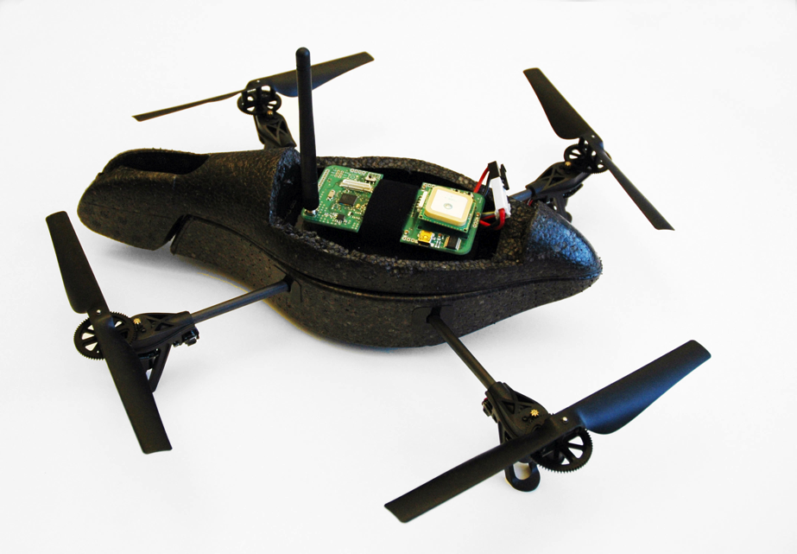
Example System: Small UAV
Digital Compass
1km Low-Speed Radio (802.15.4)
Barometric Pressure
GPS
Front Facing Camera
Rate Gyro (internal)
3-axis Accelerometer
(internal)
Sonar Ranging
(under)
100m High-Speed Radio (802.11) (internal)
Down Facing Camera (under)

Slide 48



UAV Motivation
Surveillance / Video
Infrastructure Inspection
Search and Rescue
Atmospheric Sensing
Ad-hoc Communication Networks

Slide 49
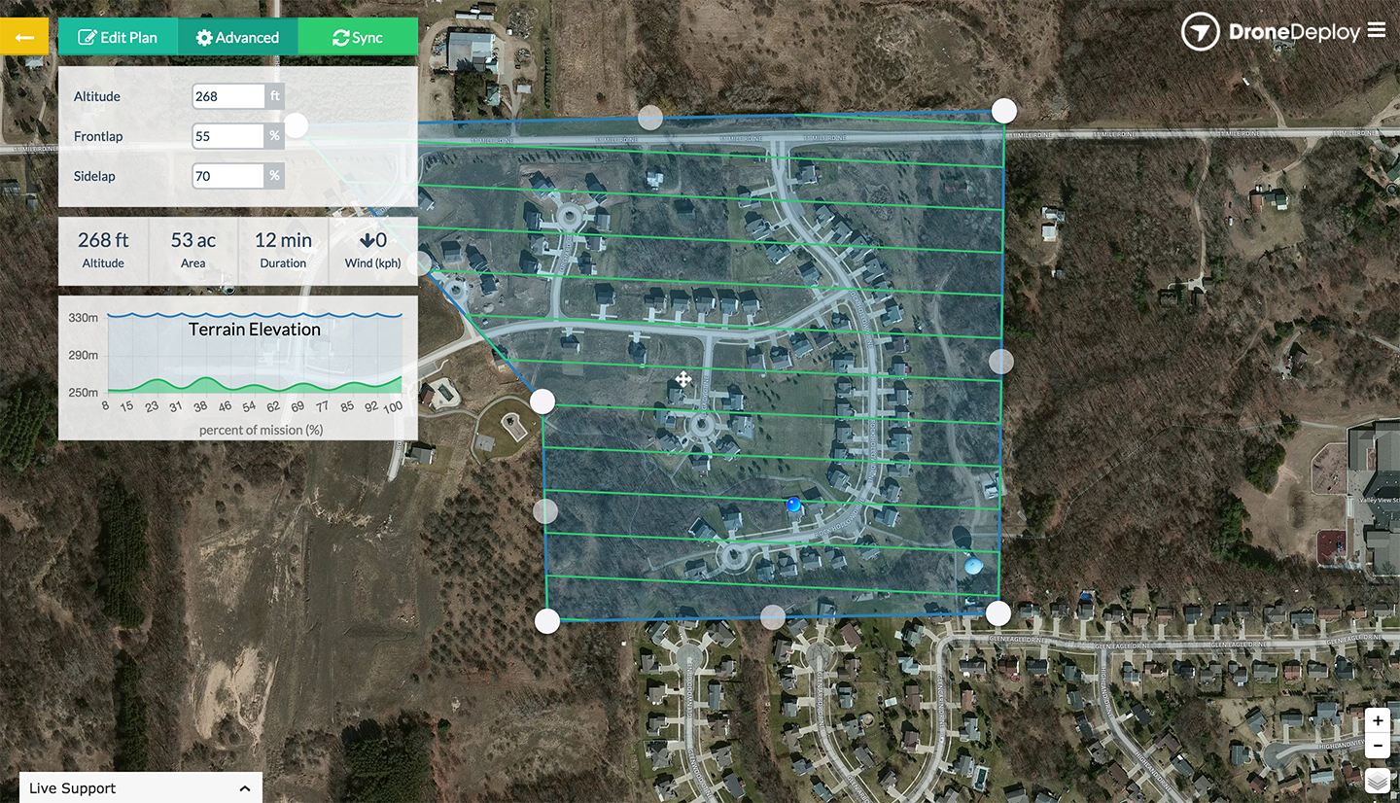

3DR Construction Mapping

Slide 50

Example System: Small UAV
Low-Level Control, Networking, Image Compression, Path Planning
Compute
User
Sensors
Actuators
GPS, Pressure, Propeller Speed, roll, pitch, yaw, bearing, camera data
Propeller Speed
Physical World

Slide 51
Linux
468MHz ARM9
128MB RAM
Serial
Motors x 4
(local speed controller)
PIC24
40MHz,
4KB RAM
Rate Gyro
Accel.
Serial
Ultra-Sound
Camera PPI x 2
(DMA / Video4Linux)
Expansion Board
ATmega128rfa1
16MHz, 16KB RAM
IR
Pressure
ROCm Atheros
AR6102G-BM2D b/g Wifi
Compass
GPS
Transducer
Processor
Network Interface

Slide 52
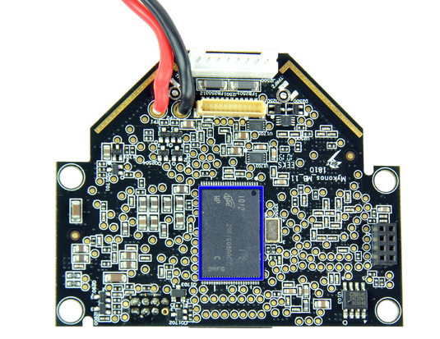
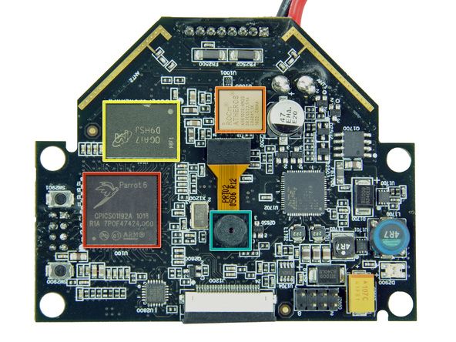
Main Board
Parrot 6 ARM9
- 468 MHz
ROCm Atheros AR6102G-BM2D b/g Wifi
Micron OGA17 D9HSJ Camera (60FPS, qcif)
Micron 29F1G08AAC Camera

Slide 53
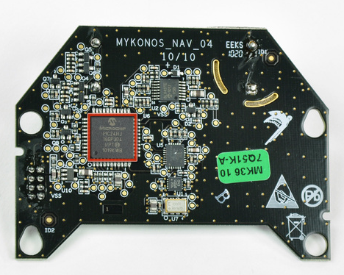
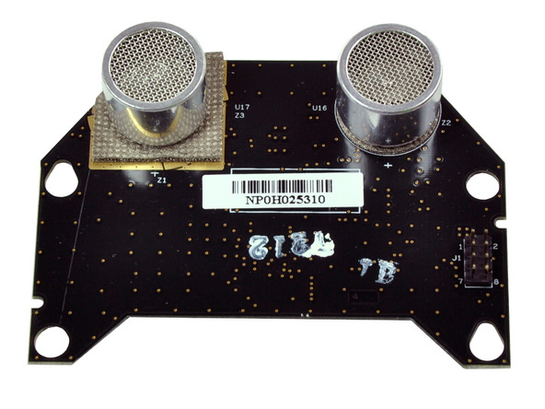
Sensor Board
PIC24HJ16GP304
- 16 bit, 40 MIPS, 4K RAM, 32K FLASH
2 axis Accelerometer, 3 axis Rate Gyro (Invensense IDG 500), Ultrasound (6 meters)

Slide 54
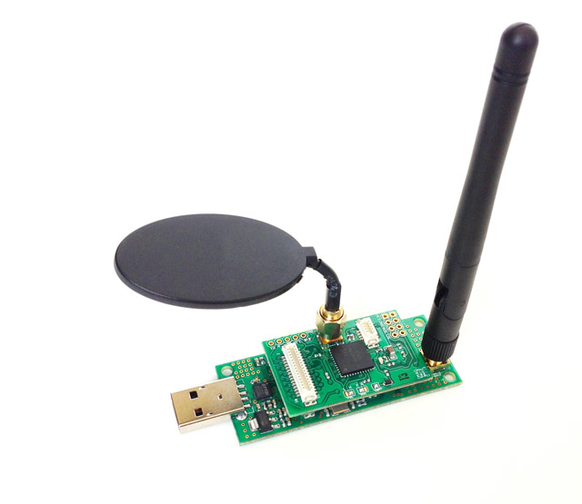
Custom Expansion Board
Micro-controller
GPS
Long Range Radio
Sensor Interface

Slide 55
RT Prio System
Low-level Flight Control
Actuation Task
Sensor Data Task
Aux Sensor Data
Video
RT Prio User
Navigation Task
Object Detection Task
Video Streaming Task
Linux Non-RT
. . .
ftpd
crond
ntpd
network

Slide 56
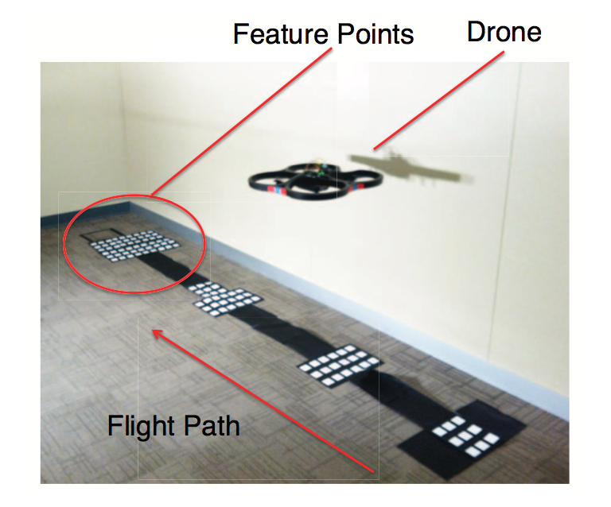
Experimental Setup

Slide 57
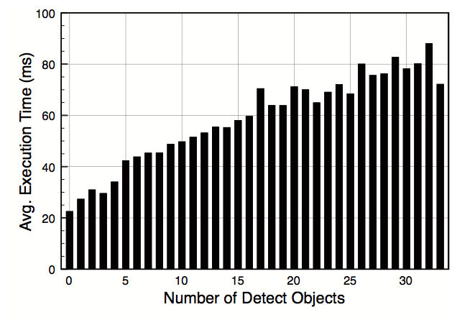
Dynamic Workload (Image processing)

Slide 58
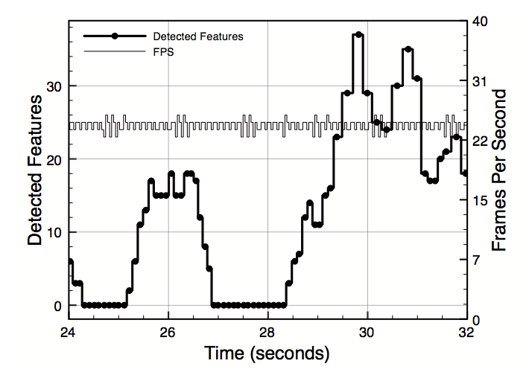
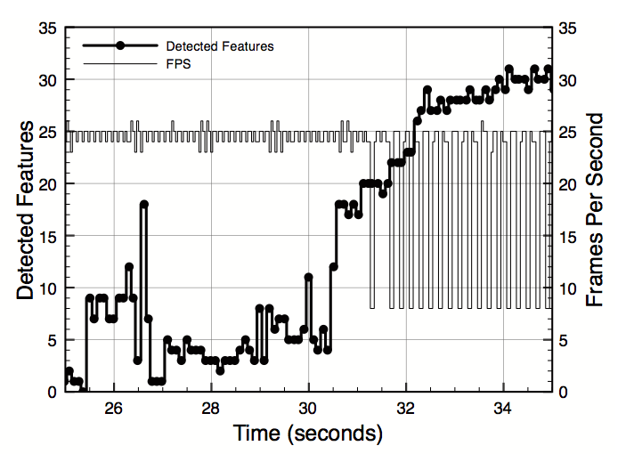
Linux vs RT-Linux
QoS degraded

Slide 59
Summary
OS Approaches limiting Real-time and Non-Real-time Task Interactions
Compliant Kernel Approach
Thin Kernel Approach
OS Approaches that integrate Real-time and Non Real-time tasks
Core Kernel Approach
Resource Kernel Approach
Next Lecture: PID Control (guest lecture) + Lab Overview
Notes:
15

